Slide 1

Capstone Project Title
Presented By
Student Name(s) :
Registration Number :
Course Name and Code :
Faculty :
Date :31.8.26
DHAARANEE SRI (1919260002)
SUBASH SURYA N (1924260164)
DURGA DEVI.G (1921260128)
PADMAPRIYAN M (1924260030)
SAINDHAVHI JS (1911260119)
CSA0803 - PYTHON PROGRAMMING
Dr Samson Ebenezar

Slide 2
Introduction
Digital Transformation in Academics: The rapid shift towards computer-based testing requires scalable, error-free assessment platforms.
Overview: A centralized Python-based platform designed to create, conduct, and automatically evaluate objective and multiple-choice assessments.
Instant Feedback Mechanism: Eliminates delays in score generation through real-time auto-grading algorithms.
Core Philosophy: Reduces logistical overhead, saves paper, and delivers an unbiased evaluation environment.

Slide 3
Problem Statement
Time-Consuming Manual Grading: Traditional paper-based exams require extensive manual grading, leading to human error and delays.
Resource Inefficiency: High consumption of physical resources (paper, printing, invigilation coordination).
Security & Cheating Risks: Challenges in maintaining question randomization and prevent unauthorized access during tests.
Data Inconsistency: Difficulties in securely storing, tracking, and retrieving historical student test records.

Slide 4
Objectives of the Project
Automate Assessment: Develop an algorithmic auto-evaluation pipeline for instant result generation.
Role-Based Access: Provide distinct panels with proper authentication for Administrators/Teachers and Students.
Question Bank Management: Enable teachers to add, modify, categorize, and randomize questions.
Performance Analytics: Automatically generate scorecards and performance summaries for students and faculty.
Integrity & Time Limits: Implement real-time countdown timers and auto-submission upon timer expiration.

Slide 5
Scope of the Project
In-Scope:
User registration and role-based login (Admin/Teacher & Student).
Timed MCQ tests with automated randomized question ordering.
Instant auto-grading against standard answer keys.
Exporting results/analytics to CSV/PDF or dashboard viewing.
Out-of-Scope (Future Enhancements):
Advanced subjective long-answer grading using NLP.
AI-based remote webcam proctoring and biometric identity verification.

Slide 6
Related Work
Previous Systems & Technologies:
System 1: Native Desktop GUI Application: Built using Python's tkinter library to eliminate browser dependencies, external hosting costs, and network loading delays.
System 2: Lightweight & Standalone execution: Runs directly on standard desktop environments with minimal dependencies and fast GUI rendering.
System 3: Structured Test & Timer Management: Features direct event-driven UI updates for precise exam time tracking, dynamic question rendering, and real-time score processing.
.

Slide 7
Related Work
Identified Gaps to fill:
Need for lightweight, rapid Python implementation with structured database integration.
Better randomized question distribution to minimize peer-to-peer malpractice.
Lack of instant visual analytics and report generation for students.
.

Slide 8
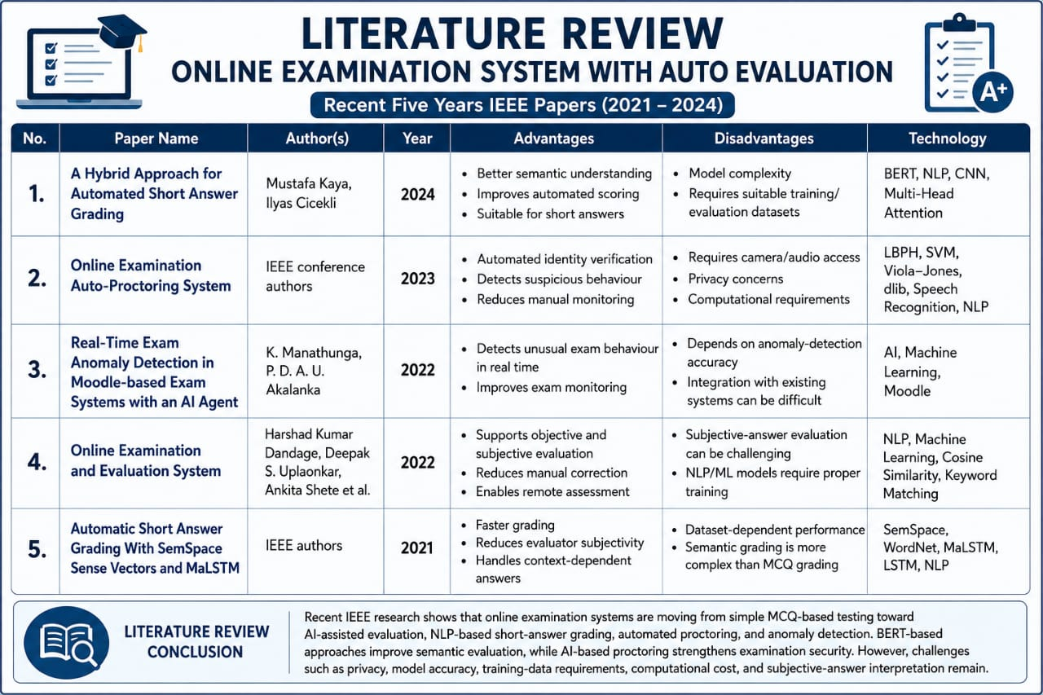
Literature Review

Slide 9
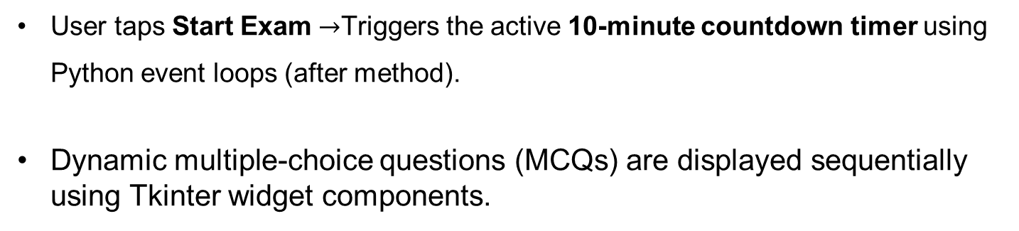
Methodology / System Design
Deployment & Initialization:
Extract the project .zip file and run main.py using Python runtime.
System initializes into a desktop-native Tkinter GUI Start Exam landing interface.
2. Exam Session & Timed Execution:
User taps Start Exam $→$Triggers the active 10-minute countdown timer using Python event loops (after method).
Dynamic multiple-choice questions (MCQs) are displayed sequentially using Tkinter widget components.

Slide 10
Methodology / System Design
3. Response Capture & Auto-Evaluation:
Candidate selects responses for the MCQ set.
System automatically compares selected choices against stored answer keys upon manual submission or timer expiration.
4. Result Generation & Retake:
Instant Result Page: Displays total score, calculated percentage, and performance summary
Retake Mechanism: Enables candidates to reset the session and restart the examination cleanly..

Slide 11
Methodology / System Design
Extract ZIP & Run main.py
│
▼
Tkinter Main Window / Start Screen
│
▼
[ Start Timer (10 Min) & Load MCQs ]
│
▼
Record Candidate Answers
│
▼
Submit / Auto-Submit on Timeout
│
▼
Auto-Evaluation Engine
│
▼
[ Display Score, % & Retake Option ]

Slide 12
Module Description
User GUI & Interface Module: Renders the main window using Python Tkinter components (Labels, Buttons, Radiobuttons) for seamless exam navigation
Question Data Module: Manages the structured list of multiple-choice questions, options, and correct answers directly within Python data structures.
Timer & Session Engine Module: Controls the 10-minute countdown using Python event loops (after method) and handles candidate selection tracking.
Auto-Evaluation & Results Module: Computes total scores and percentages upon submission or timeout, presenting the final feedback and retake option dynamically.

Slide 13
Expected Outcome
Automated Result Pipeline: 100% reduction in grading turnaround time with zero human calculation errors.
Comprehensive Dashboards: Instant student performance summaries with percentage breakdown and answer reviews.
High Efficiency & Scalability: Lightweight Python architecture capable of managing multiple exams simultaneously.
Data Portability: Clean export of class grade sheets in structured formats (CSV/Database tables).

Slide 14
Tools and Technologies
Frontend & Structure:
. Python Tkinter: Serves as the primary graphical framework to build native desktop GUI windows, frames, buttons, labels, and radio buttons
Tkinter Canvas / Geometry Managers: Handles dynamic layout positioning and visual formatting natively within the desktop application.
Core Logic & Scripting:
Python: Powers application initialization, active 10-minute timer threads/event loops, MCQ state tracking, dynamic score calculation, and exam reset logic

Slide 15
Tools and Technologies
Execution & Deployment Environment:
Python Runtime Environment: Executes the application locally using Python, rendering the native graphical interface directly without requiring external software dependencies.
Distribution: Packaged as a portable standalone .zip archive containing main.py for easy cross-platform desktop deployment and local execution.

Slide 16
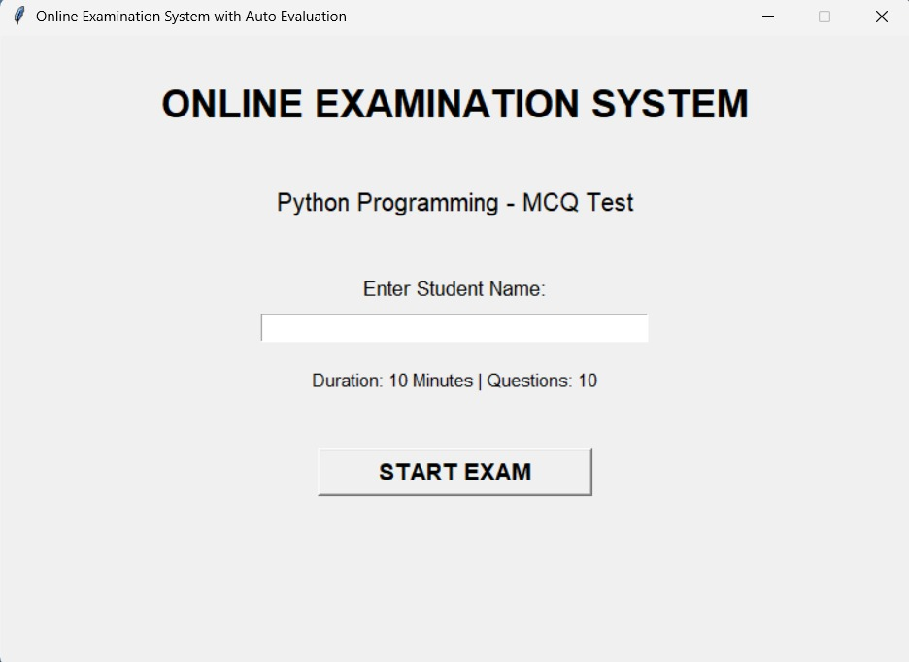
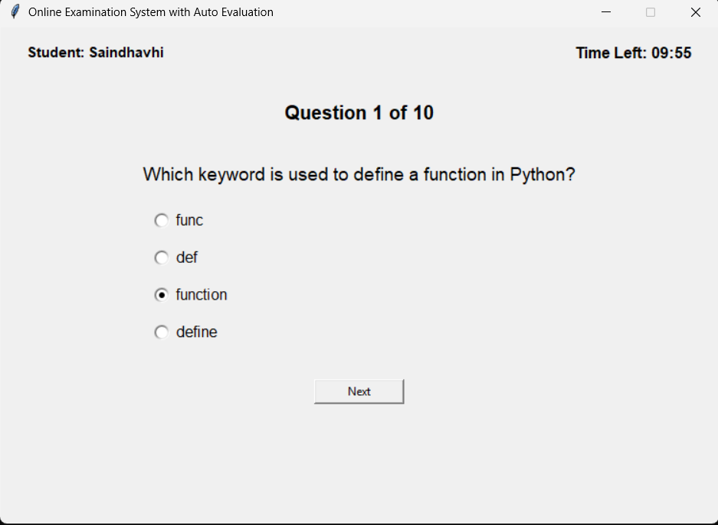
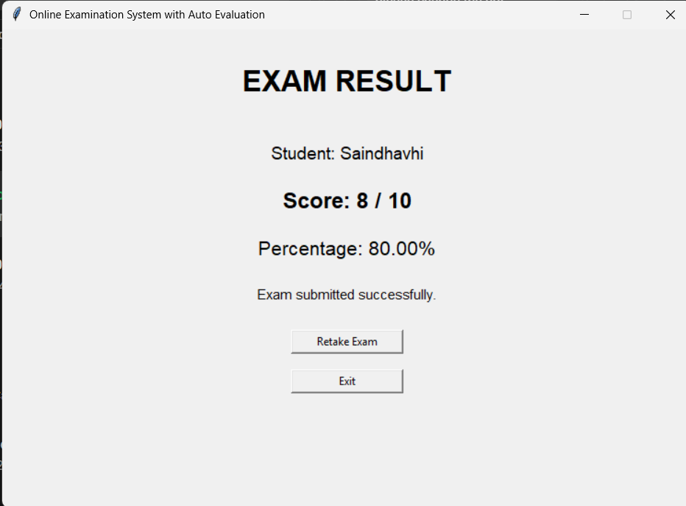
Output/ Result

Slide 17
Work Plan / Timeline
Day | Phase | Key Deliverables
Day 1 | Problem Identification & Requirements | Scope definition, mapping exam parameters, and Python Tkinter GUI environment setup.
Day 2 | System Architecture & Database Design | Designing Tkinter window layouts, dynamic GUI wireframes, and data structures for questions
Day 3 | Backend Logic & Question Engine | Implementing question loading, multiple-choice option rendering, and candidate response tracking
Day 4 | GUI & Module Integration | Assembling Tkinter frames, dynamic page transitions, and integrating the 10-minute active timer using
Day 5 | Auto-Evaluation & Reporting | Instant scoring, percentage calculation, and result/retake interface.
Day 6 | Testing & Bug Fixing | Boundary testing for timer expiration, radio button selections, window resizing, and application state resets.
Day 7 | Documentation & Final Presentation | Code cleanup in main.py, project packaging (.zip), final presentation, and report write-up.

Slide 18
Conclusion and Future Plan
Conclusion:
The developed Python-based Online Examination System delivers a secure, streamlined, and automated testing experience.
Significantly minimizes administrative overhead while ensuring transparent and instantaneous evaluation.

Slide 19
Conclusion and Future Plan
Future Scope:
Integrating AI-based computer vision for automated facial and tab-switch proctoring.
Integrating Natural Language Processing (NLP) models (e.g., BERT/Transformers) for semantic evaluation of subjective text answers.

Slide 20
Thank You

